Slide 1

Digital Resources Building and Digital Humanities in CADAL
Administration Center of CADAL
Zhejiang University Libraries
Mar. 2016 @ 西雅图

Slide 2
Outline
Overview of CADAL
Digital Humanities in CADAL
Welcome to Join in

Slide 3
Overview of CADAL
  China Academic Digital Associative Library
  CADAL is aiming to construct an academic digital library with high-level tech and abundant digital resources in multi- disciplines, multi-categories, and multi-lingual, which involves participations and services from domestic & foreign libraries, different academic organizations and experts with various specialties.
3

Slide 4



Overview of CADAL
Started from 2001, proceed in 3 phases.
Phase I:
10th Five-year Plan
Phase II:
11th Five-year Plan
Phase III:
12th Five-year Plan
2001
2003
2005
2007
2009
2011
2013
2015
2017
1 Million books digitized,
70 Million CNY funded by Chinese Government
Add 1.5 Million books,
150 Million CNY Funded by Chinese government
Add more resources,
Step into Knowledge Center
4
Notes:
During its first phase, the Chinese government invested 11 million dollars while the US partners invested about 2 million dollars to build up digital resources with 1,000,000 books, and it has been accomplished during “The tenth five- year plan of China”.
For the second stage, another 1.5 million items were digitalized, and a digital library data service center was established at Zhejiang University to achieve data security and global service. The project was financially supported by Chinese government with 24 million dollars and finished in three years.
From the third phase of the project, CADAL project will try to achieve the goal of knowledge reconstruction and information innovation with the integration of resources, as well as continued efforts on resource construction, and finally grow into an integrated academic digital library system with various functions such as resource acquisition, information reorganization, content creation, on-demand publishing, personalized service.

Slide 5
CADAL has completed digitization of 2.7 million items，and become one of the largest digital libraries.
5

Slide 6
6
Overview of CADAL
Domestic partners increased up to 70
Tsinghua University Library
Peking University Library
Jilin University Library
Xi'an Jiaotong University Library
Zhejiang University Library
Fudan University Library
Nanjing University Library
Wuhan University Library
Zhongshan University Library
China Agricultural University
Documentation and Information Center, Chinese Academy of Sciences
Shihezi University in Xinjiang
South China University of Technology
Jinan University
The University of Hong Kong
The Chinese University of Hong Kong
University of Electronic Science and Technology
Nanchang University
Suzhou University
Central Radio and Television University
North National University
Guangxi University
Chongqing University
Harbin Institute of Technology
6

Slide 7
Overview of CADAL
Overseas cooperation institutions
Carnegie Mellon university（CMU）
Cornell University Library
Harvard-Yenching Library
Columbia University Library
University of Illinois at Urbana-Champaign
The University of Chicago Library
University of British Columbia Library, Canada
Stanford University
Yale University
Michigan State University Libraries
Internet Archive
German National Library
Centre de recherché nationale en sciences humaines
The City University of Hong Kong Library
The University of Hong Kong Library
The Chinese University of Hong Kong Library
Hong Kong Baptist University Library
The Library of Alexandria, Egypt
Germany Berlin State Library
Oxford University Press
Indian Institute of Science (Bangalore)）
Education Research Network (Delhi)
Anna University
……
7
Notes:
Ivy league Universities
7

Slide 8
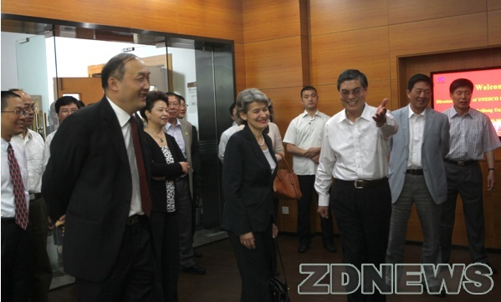
May 15 2012, director–general of UNESCO (United Nations Educational Scientific and Cultural Organization) Ms. Irina Bokova visited CADAL.
8

Slide 9
Nov. 5, 2012, assistant director-general of UNESCO Ms.Kallunki visited CADAL.
Aug. 2013, UNESCO passed a resolution to found the Engineering Knowledge Center in China.
9

Slide 10
Outline
Overview of CADAL
Digital Humanities in CADAL
Welcome to Join in

Slide 11
海量文学史信息的收集、组织和管理
49593段文学史信息
21939个古现代地点
6516位文学家，包括其画像、年表、年谱、相关作品等信息
3829篇诗词
2599个古迹信息，包括 介绍及图片信息
519个文学史相关视频
中国历代地理信息数据
中国历史地名对照表（到县级）
中国历代职官信息
中国历代年表
中国历代矢量地图，囊括从秦到清各历史朝代中最具代表性时期的三级行政区域地名
有机融合、互相关联，形成中国文学编年史系统

Slide 12
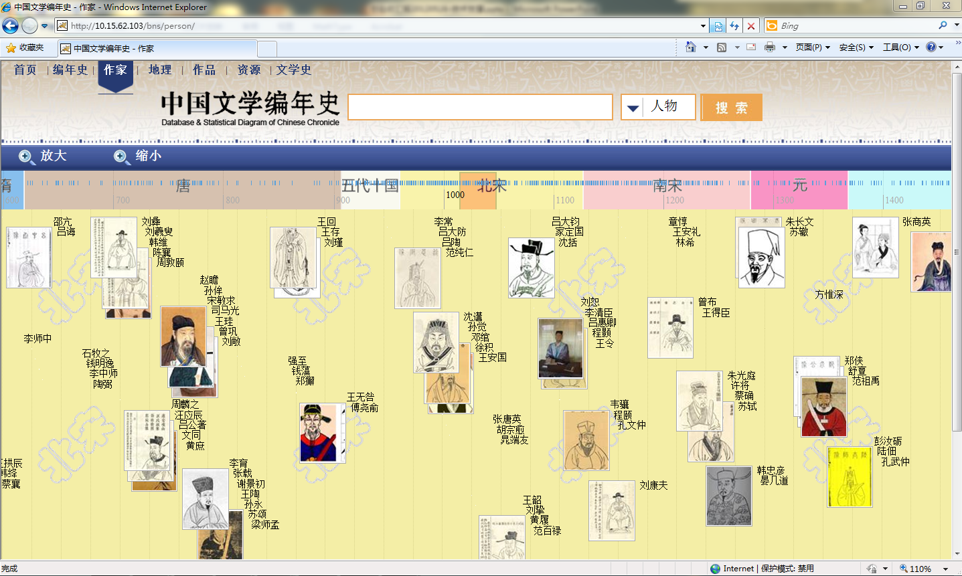
以时间轴的方式展现历代文学家

Slide 13
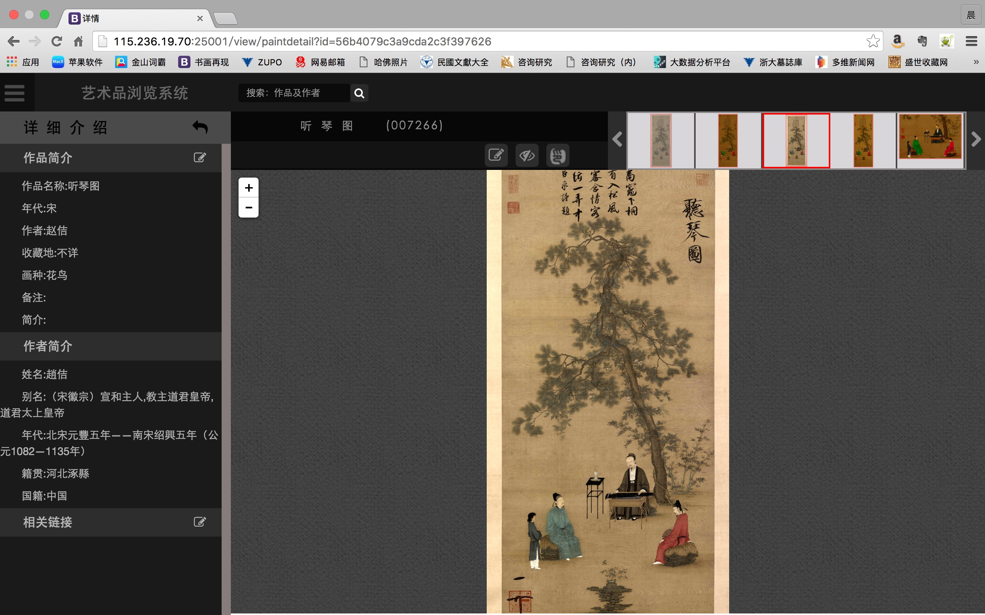

Slide 14
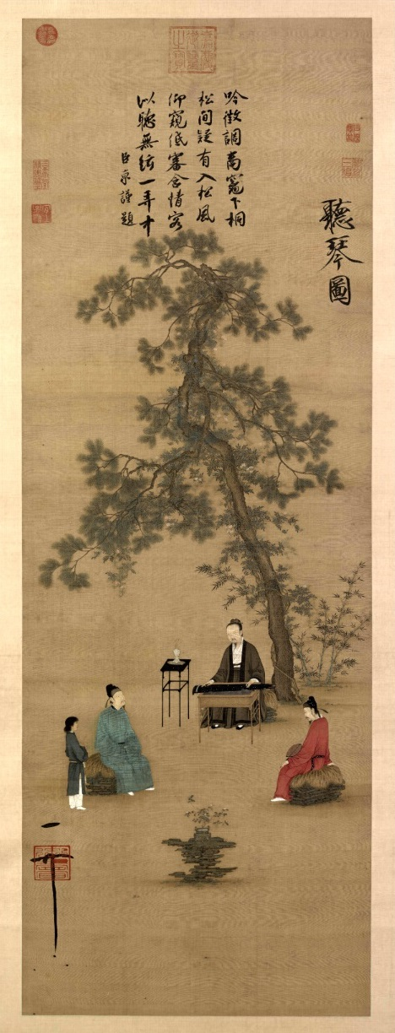

Slide 15

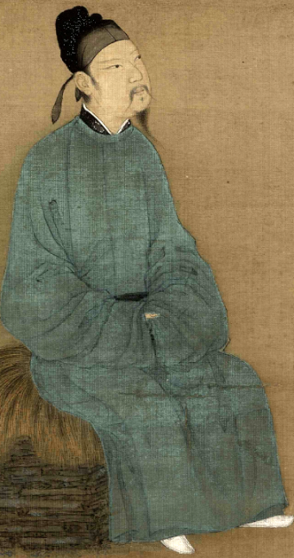

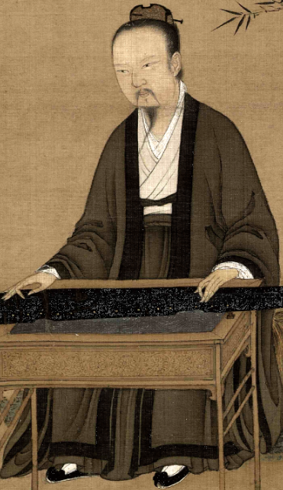
人物与衣饰

Slide 16


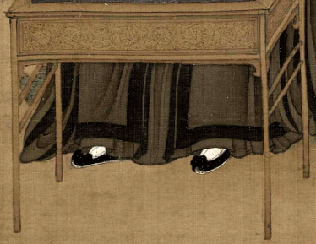


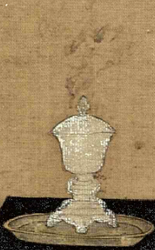
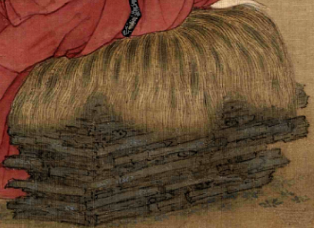
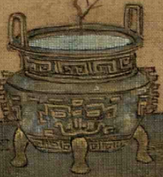
器具

Slide 17
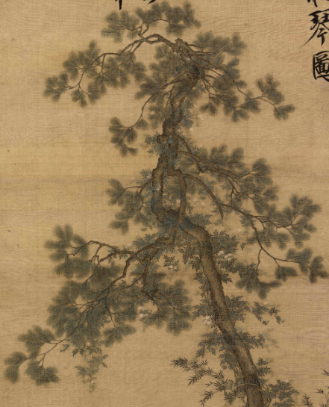






植物

Slide 18


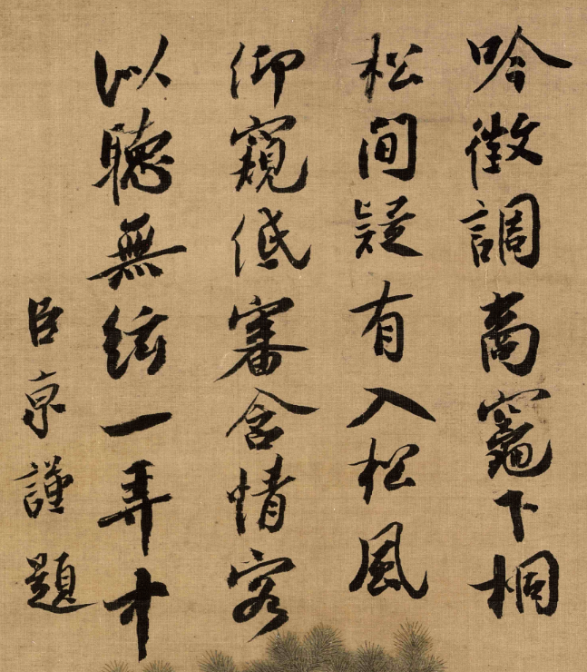
题跋、落款

Slide 19
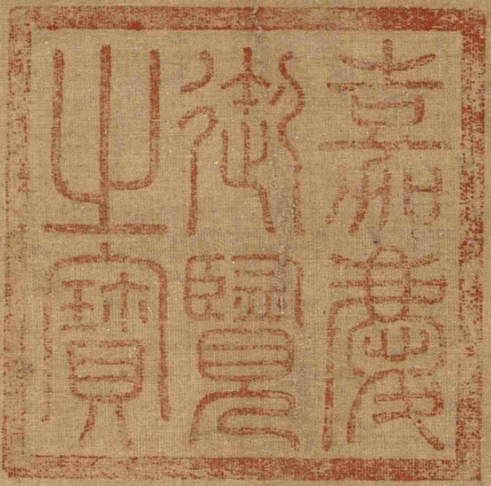

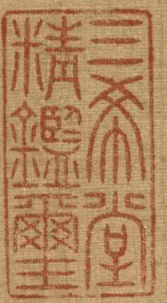

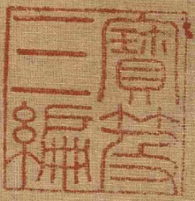
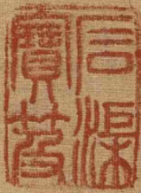
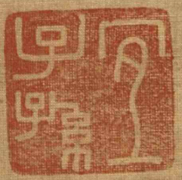
印章

Slide 20
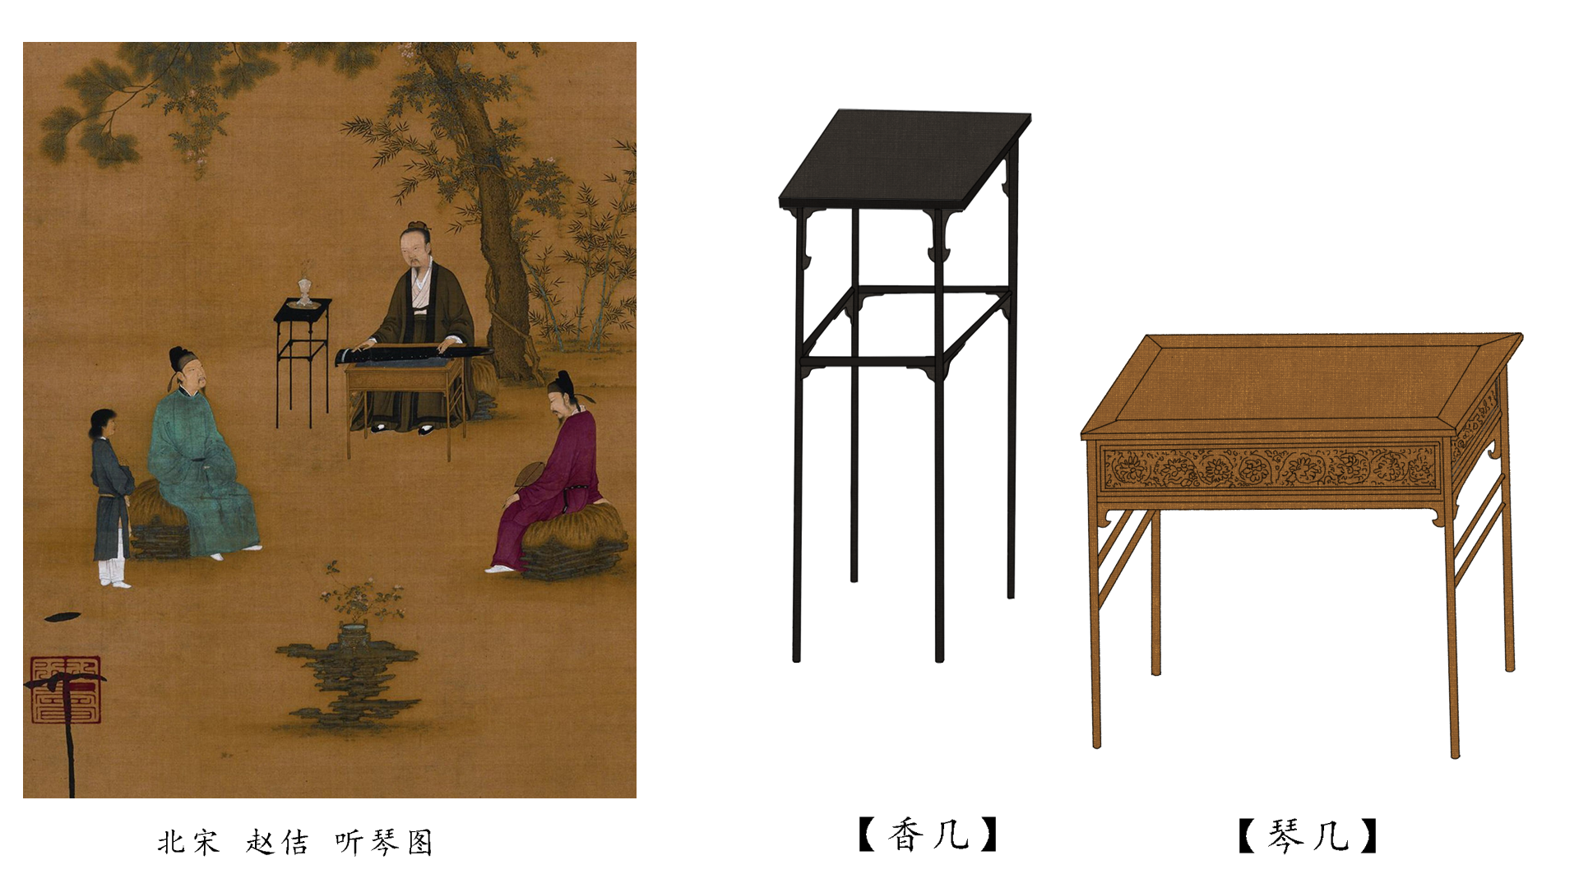
宋代文房家具研究
20
Notes:
Epigraph, Stone inscription

Slide 21
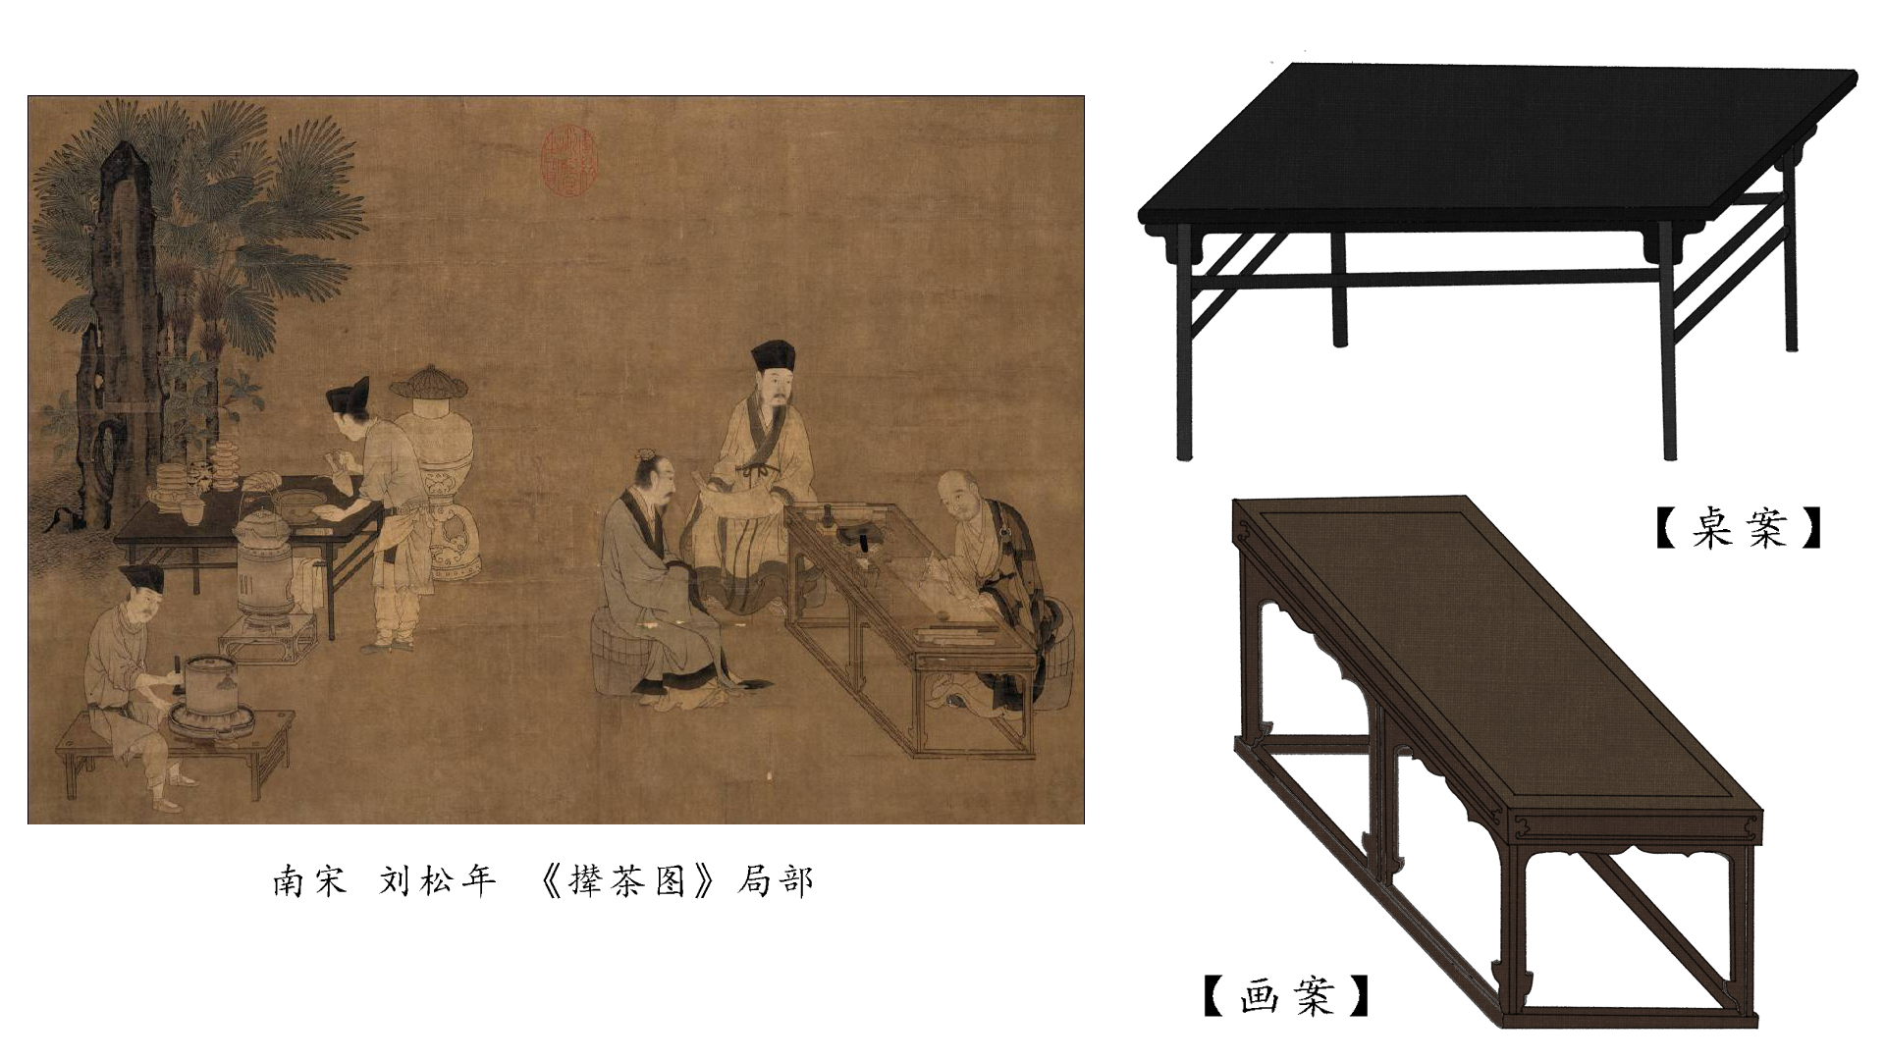
宋代文房家具研究
21

Slide 22
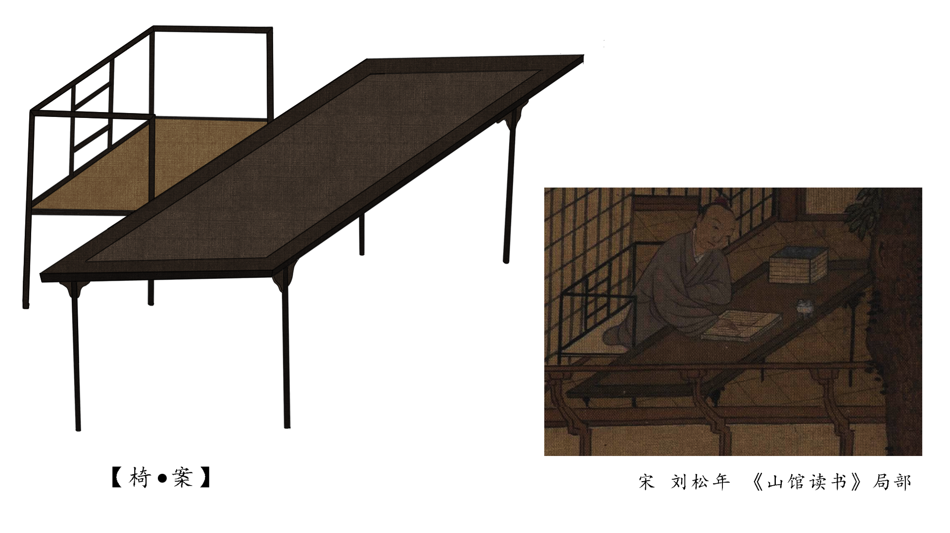
宋代文房家具研究
22
Notes:
Epigraph, Stone inscription

Slide 23
Outline
Overview of CADAL
Digital Humanities in CADAL
Welcome to Join in

Slide 24
Welcome to Join in
  http://www.cadal.cn/xmjj/glbf.htm
  http://www.cadal.cn/jrwm/
Cooperation
  Digital resources
  Digital library services
  Digital library techniques
  ……

Slide 25
Welcome to Join in
cooperation modes
  Applicants provide a certain number of copies of its digitized resources to CADAL.
  Or provide a certain number of books for CADAL to digitalize.
  The leading entities of alliances, established by some relevant overseas agencies to construct and share digital resources, shall take the responsibility to declare to participate in CADAL projects as a unit. And the leading entities shall also take the responsibility mentioned above.
  ……

Slide 26
Welcome to Join in
Apply
  download and fill in the “Declaration Form for Constructing and Sharing Digital Resources of Overseas Agencies”
  Signed the application and submit to CADAL
Review
  CADAL review the written application materials the main qualifications and other materials
  CADAL organize the assessment of experts to review copies of digital resources and other contents
  Inform the result of the review
Cooperate
  discuss details and sigh agreement
  Cooperate begin

Slide 27
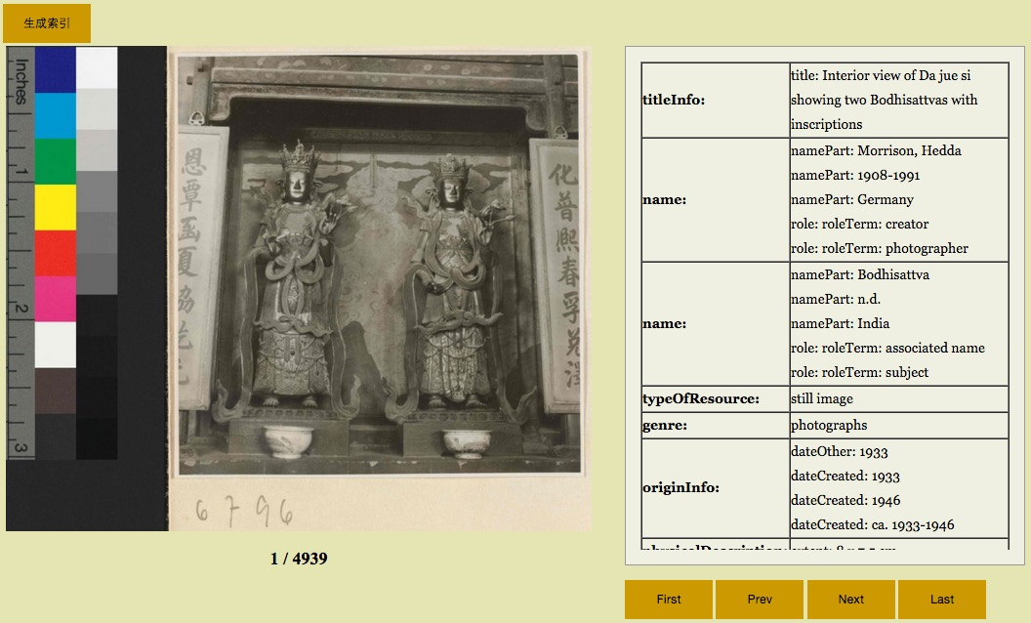
哈佛燕京提供资源
27
Notes:
Epigraph, Stone inscription

Slide 28
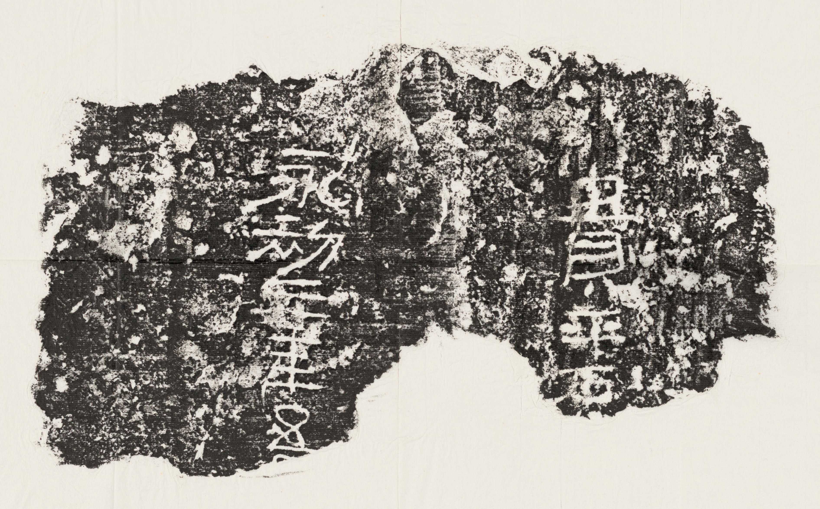
title | 永初元年貴平治黃腸石
place | 洛陽
dateIssued | 東漢永初元年[107]
edition | 原刻
note | 拓片, 摺葉, 未托裱, 墨紙尺寸: 17 x 29 cm
 | 隸書
 | 民國拓本
relatedItem | 居貞草堂漢晉石影
Contribute | Harvard Yenching Library Chinese rubbings digitization project
28
Notes:
Epigraph, Stone inscription

Slide 29
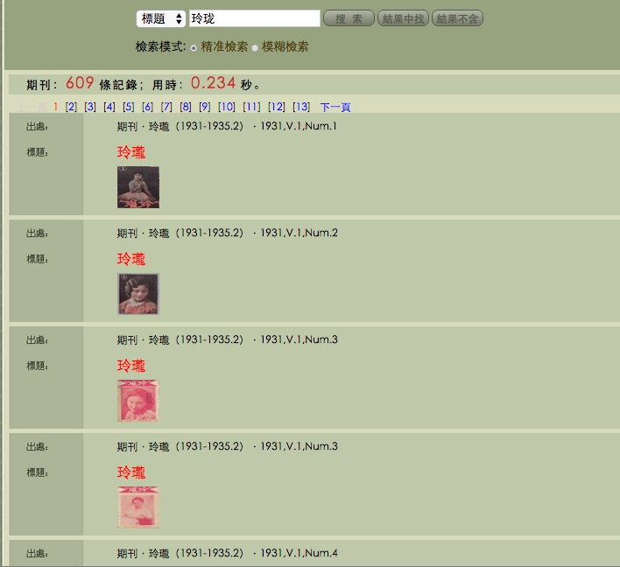
29
哥伦比亚大学东亚馆提供资源
Notes:
Epigraph, Stone inscription

Slide 30
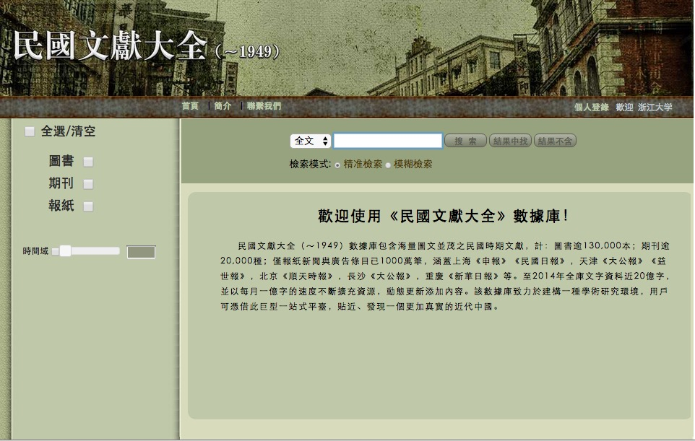
CADAL项目的ＩＲ尝试
30
Notes:
The republic of China

Slide 31

CADAL项目的ＩＲ尝试
民國文獻大全 概況
cadal.hytung.cn
記錄條目：24,913,859 條
圖版總數：36,525,161 幀
圖版首尾銜接長度達到一萬公里
海量資源，一站大全
31
Notes:
The republic of China

Slide 32
CADAL项目的ＩＲ尝试
民國文獻大全 概況
包含CADAL數據：
圖書：128,721本/冊、標引條目4,530,528筆；
期刊：21,083 種、131,813期、2,763,615篇；
【特點】圖像為主，標引為輔。
圖版總量35,105,967 幀；文字總量2億字。
32
Notes:
The republic of China

Slide 33
CADAL项目的ＩＲ尝试
民國文獻大全 概況
包含公司數據：
期刊： 5,644,148 條記錄；
報紙：11,975,568 條記錄（新聞和廣告）
含上海《申報》、《民國日報》，天津《大公報》《益世報》，北京《順天時報》等十餘種民國大報
【特點】以報紙和全文為主。其中圖版142萬幀，期刊文字量3億，報紙文字量約20億。
33
Notes:
The republic of China

Slide 34
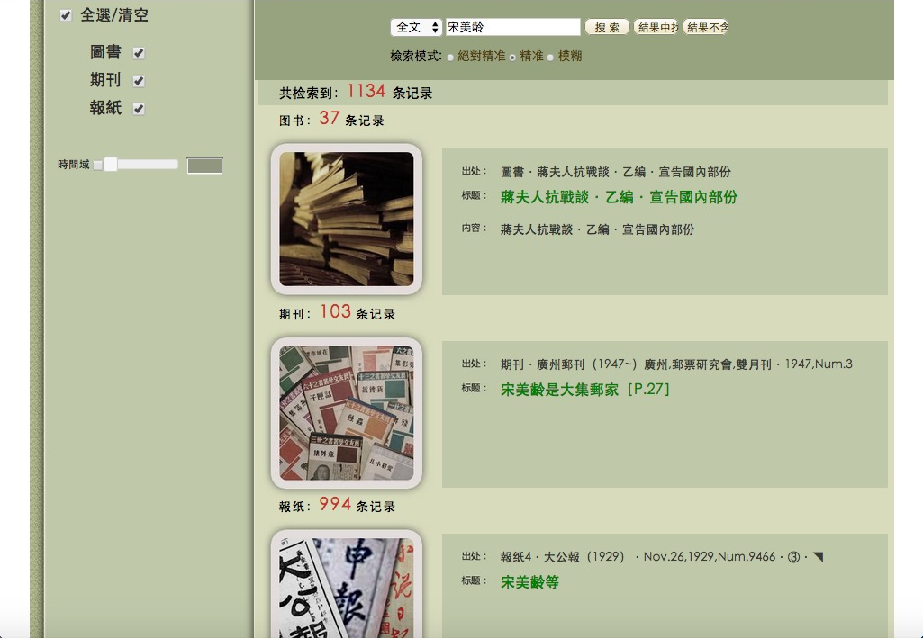
34
Notes:
Epigraph, Stone inscription

Slide 35
Welcome to Join in
Review
  The copies of the digitized resources or the sum of the books and the copies offered by an applicant shouldn’t be less than 3000.
  The copies of digital resource and books provided by applicants will be assessed by CADAL.
  Chinese resources or non-Chinese resources about China will be considered preferentially
  The applicant shall own the copyright or the corresponding disposition of offered resources.
  The conditions of rare and special collection can be appropriately relaxed assessed and admitted by CADAL.
Notes:
不少于3000册；内容评估；中文或研究中国；拥有版权；特藏资源

Slide 36
Welcome to Join in
CADAL give the authority to access digital recourses services to the users of the applicants within its corresponding IP range (more than 1.75million books).

Slide 37


